Slide 1

High-dimensional dynamics of training and generalization in neural networks: insights from the linear case
Andrew M. Saxe
Department of Experimental Psychology
University of Oxford

Slide 2
The mysteries of depth
Deep networks work incredibly well
They compactly represent complex functions (Hinton & Salakhutdinov, 2006; Bengio & LeCun, 2007)
But naïve deep learning is ‘hard’

Slide 3
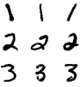
Depth complicates learning
0
1 … 8 9
Training error
Epochs

Slide 4
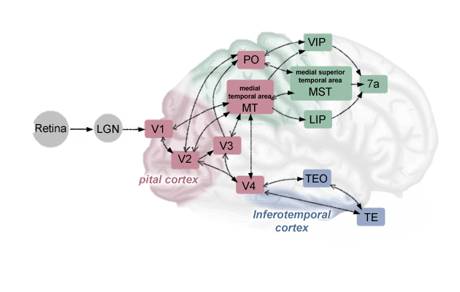
Depth: Layered anatomy
Ventral visual cortex: ~5 serial stages
http://www.eyebrainpedia.com/En/Localisation/images/EncephaleAiresVisuellesPosterieures.png

Slide 5
Depth: Layered anatomy
Douglas & Martin, 2004
Within each area: ~2-3 layers
http://www.eyebrainpedia.com/En/Localisation/images/EncephaleAiresVisuellesPosterieures.png

Slide 6
Towards a clarifying theory
What role does depth itself play in complicating learning dynamics?
What features of the training setup determine training speed?
How will deep networks generalize to novel inputs?

Slide 7
Outline
Theory of deep linear learning
Training dynamics
Scaling laws
Generalization dynamics

Slide 8
Deep linear neural networks
Develop theory using a simple model class
Particularly for brain sciences, crucial to have a minimal, tractable model
Conceptual clarity
Unambiguous predictions
Isolate contribution of depth

Slide 9
Deep network
Little hope for a complete theory with arbitrary nonlinearities
. . .
x

Slide 10
Deep linear network
Use a deep linear network as a starting point.
. . .
x

Slide 11
Deep linear network
Input-output map: Always linear
Controls for representational power
Isolates impact of depth

Slide 12
Trivial?
Plateaus and sudden transitions
Faster convergence from pretrained initial conditions
Random ICs
Pretrained
Training error
Training error
Epochs
Epochs
Build intuitions for nonlinear case by analyzing linear case
Will give exact analytic description of these error curves

Slide 13
Linear map, nonlinear learning
Input-output map: Linear
Error function: Nonlinear
Learning problem: Nonconvex (for D>1)

Slide 14
Decoupling depth & nonlinearity
Shallow
Deep
Linear
Linear Regression
Deep Linear Networks
Nonlinear
Support Vector Machines
Deep Networks

Slide 15
Representational power
Shallow
Deep
Linear
Cannot solve XOR
Cannot solve XOR
Nonlinear
Can solve XOR
Can solve XOR

Slide 16
Learning dynamics
Shallow
Deep
Linear
Convex learning
Nonconvex learning
Nonlinear
Convex learning
Nonconvex learning

Slide 17
Gradient descent
Gradient descent eqns: Nonlinear, coupled (for D>1)
Input correlations:
Input-output correlations:
Goal: Solve these equations to reveal full learning trajectories.

Slide 18
Deep linear networks
Prior work:
Critical points: Baldi & Hornik, 1989
Shallow dynamics: Chauvin, 1991; Krogh & Hertz, 1992
Three layer dynamics: Fukumizu, 1998
Nonlinear: Saad & Solla, 1995; Seung, Sompolinsky, & Tishby, 1992; Amari et al., 1995; Opper, 2001
Need analysis for deeper networks

Slide 19
SVD change of variables
Grow
G
1
1
Move
M
2
2
Roots
R
Modes
Modes
World
3
3
Properties
Properties
Fly
F
4
4
Swim
S
1
2
3
4
Bird
Fish
Tree
L
Flower
Leaves
Modes
Items
Petals
P
Bird
Fish
Tree
1
2
3
4
Flower
Items
Modes
Grow
G
1
1
Move
M
2
2
Roots
R
Modes
Modes
Network
3
3
Properties
Properties
Fly
F
4
4
Swim
S
1
2
3
4
Bird
Fish
Tree
L
Flower
Leaves
Modes
Items
Petals
P
Bird
Fish
Tree
1
2
3
4
Flower
Items
Modes

Slide 20
Hidden 1D networks
SVD change
of vars
Decoupled
Initial conds
N independent, scalar modes

Slide 21
Anatomy of a mode
Overall effective singular value
Effective layer weights

Slide 22
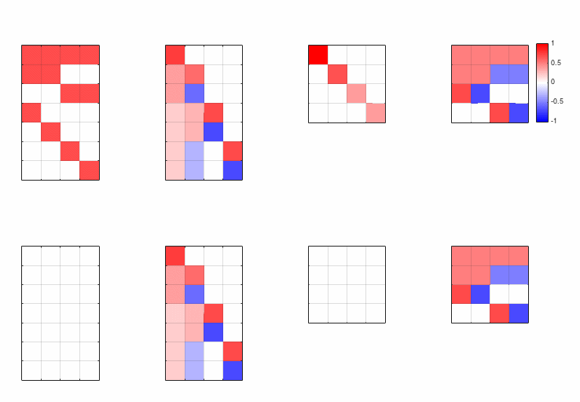
SVD change of variables
Grow
G
1
1
Move
M
2
2
Roots
R
Modes
Modes
World
3
3
Properties
Properties
Fly
F
4
4
Swim
S
1
2
3
4
Bird
Fish
Tree
L
Flower
Leaves
Modes
Items
Petals
P
Bird
Fish
Tree
1
2
3
4
Flower
Items
Modes
Grow
G
1
1
Move
M
2
2
Roots
R
Modes
Modes
Network
3
3
Properties
Properties
Fly
F
4
4
Swim
S
1
2
3
4
Bird
Fish
Tree
L
Flower
Leaves
Modes
Items
Petals
P
Bird
Fish
Tree
1
2
3
4
Flower
Items
Modes

Slide 23
Mode error surface
Mode error surface:
Balanced ICs:
Singular value
Input variance

Slide 24
Error surface
S=2, =1

Slide 25
Minima
S=2, =1

Slide 26
Saddle point
Saddle point
S=2, =1

Slide 27
Saddle point
Plateau
S=2, =1

Slide 28
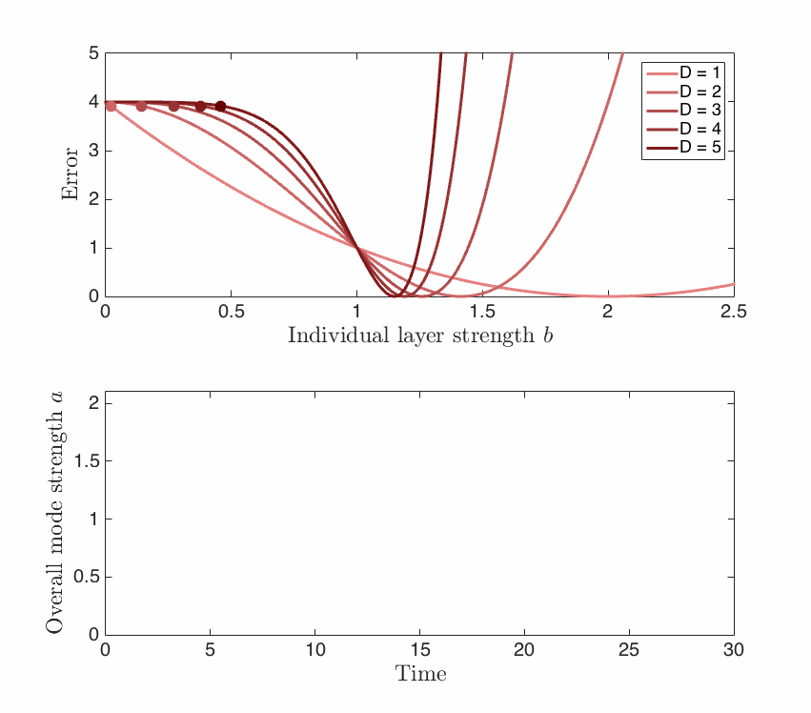
Gradient descent dynamics
S=2, =1

Slide 29
Analytic learning trajectory
Shallow (D=1):
Deep (D=2):
V. Deep (D ):

Slide 30
Analytic learning trajectory
Shallow (D=1):
Deep (D=2):
V. Deep (D ):

Slide 31
Exact solutions
Shallow
Deep
ŷ
x
ŷ
h
x

Slide 32
Timescale of learning
Each mode is learned in time
Singular values of input-output correlations determine learning speed
τ | 1/Learning rate
s | Singular value

Slide 33
Outline
Theory of deep linear learning
Training dynamics
Scaling laws
Generalization dynamics

Slide 34
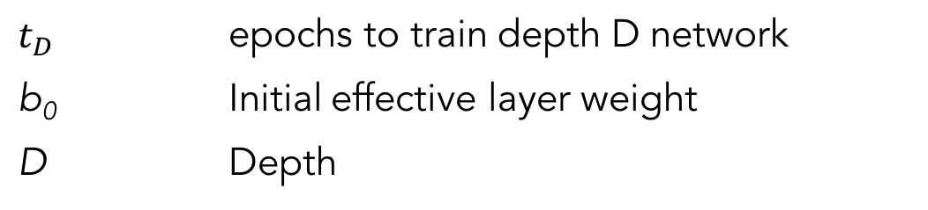
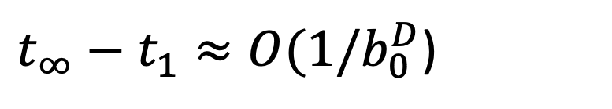
Deep scaling law
How does training speed scale with depth?
Time difference for deep net vs shallow net is
Fundamental prediction: Deep learning speed highly sensitive to initial conditions
$t_{∞}−t_{1}≈O(1/b_{0}^{D}$)
$$t_{D}$$ | epochs to train depth D network
b₀ | Initial effective layer weight
D | Depth
Notes:
We predict this, theoretically; turns out to be true, very surprising. Something remarkable: learning time in # of epochs.

Slide 35
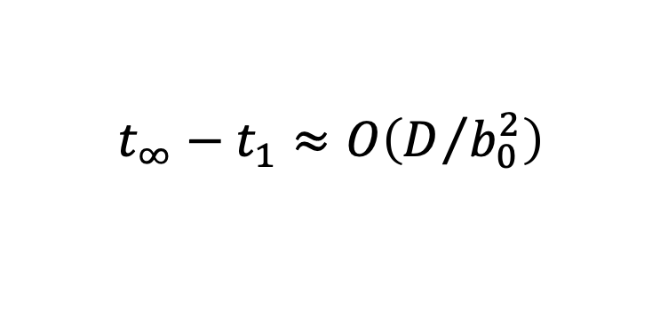
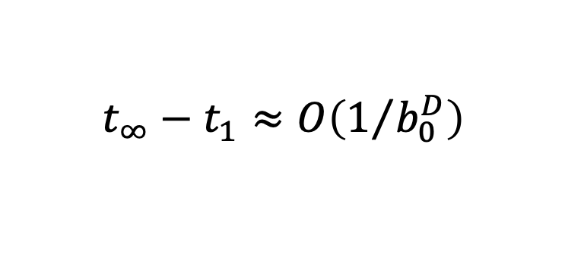
Effect of initializations
Small random weights scale exponentially
Pretraining + fine-tuning scales linearly
Orthogonal initialization: depth-independent
$$t_{∞}−t_{1}≈O\left(1/{b_{0}^{D}}\right)$$
$$t_{∞}−t_{1}≈O\left(D/{b_{0}^{2}}\right)$$
$$t_{∞}−t_{1}≈O\left(1\right)$$

Slide 36
MNIST learning speeds
Trained deep linear nets on MNIST digit classification
Depths ranging from 3 to 100
1000 hidden units/layer (overcomplete)
Decoupled initial conditions with fixed initial mode strength
Batch gradient descent on squared error
Optimized learning rates for each depth
Calculated epoch at which error fell below fixed threshold

Slide 37
MNIST learning speeds
Time to criterion
Optimal learning rate
Depth
Depth

Slide 38
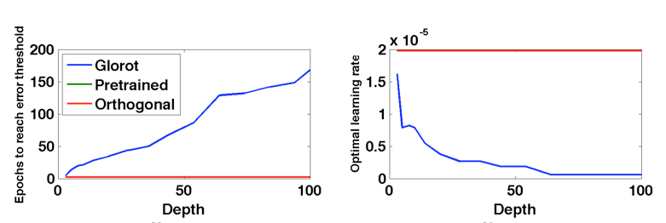
Depth-independent training time
Deep linear networks on MNIST
Glorot: Scaled random initialization (Glorot & Bengio, 2010)
Time to criterion
Optimal learning rate
Orthogonal initialization has depth-independent training times

Slide 39
Fast nonlinear deep learning
Tanh networks, 500 neurons/layer, batch GD, optimized learning rate; works for depth 1000 networks (Sussillo & Abbott, 2014)

Slide 40
Approx. depth-independent learning times in nonlinear nets

Slide 41
Interim summary: training dynamics
Depth itself—apart from neural nonlinearities—strongly impacts learning dynamics
Depth creates sigmoidal learning trajectories and long plateaus with little improvement (cf Biehl & Schwarze, 1995; Saad & Solla, 1995)
Learning speed is ordered by singular value strength and depends strongly on initialization
Caveats:
Only discussed training error (see Fukumizu, 1998; Advani & Saxe, 2017; Lampinen & Ganguli, 2018)
Balanced, decoupled initial conditions
Mutually diagonalizable input and input-output correlations

Slide 42
Outline
Theory of deep linear learning
Training dynamics
Scaling laws
Generalization dynamics

Slide 43
Generalization dynamics
Performance on novel examples is a critical measure of a learning system
How does generalization depend on
Initialization
Training duration
Dataset statistics
Model complexity (eg, # of hidden units)

Slide 44
Massive networks
Massive artificial neural networks often work well in practice
Can even have more parameters than training examples
Szegedy et al., CVPR 2015

Slide 45
Bigger is better?
ImageNet: 1.2 million examples (~2000x data aug)
Top-1 generalization accuracy (%)
# parameters
Operations (G-Ops)
Canziani, Culurciello, & Paszke, arXiv 2016

Slide 46
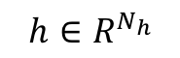
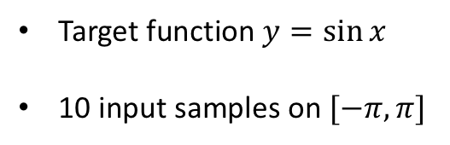
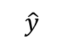
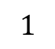
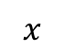
Example: fitting a sinusoid
$$\hat{y}$$
$$x$$
$$1$$
$$h∈R^{N_{h}}$$
Target function $y=\sin{x}$
10 input samples on $[−π,π]$
ReLU nonlinearity
Random first layer weights, second layer weights initially 0
Batch gradient descent on MSE

Slide 47
Overfitting in complex models
Bias
Model too simple
Variance
Model too complex

Slide 48
Overfitting in complex models
Test error (MSE)
# of hidden units

Slide 49
A puzzle?
Zhang et al., 2017: Big networks should be too complex and overfit
Naïve VC Dimension bounds predict larger networks are worse
This was also a puzzle in the past as well:
SVMs generalize well even with infinite features (infinite VC dimension kernels like RBF kernels). How?
Basic answer: regularization (Bartlett, 1998; Neyshabur et al., 2015)
SVM will generalize well if large-margin solution is found

Slide 50
A puzzle?
Well-known that the norm of a neural network’s weights bounds the complexity of the function it can represent
(Bartlett, P. L. (1998). The Sample Complexity of Pattern Classification with Neural Networks: The Size of the Weights is More Important than the Size of the Network. IEEE Trans. Info. Theory, 44(2), 525–536.)
If there is a puzzle, it is where the regularization is coming from in this instance
SGD? Limited overfitting even with BGD.
Early stopping? Limited overfitting even with long training times.
Where is the regularization in the typical training procedure for deep networks?

Slide 51
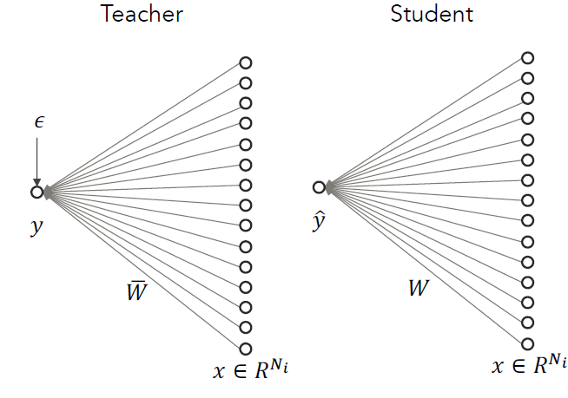
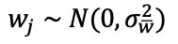
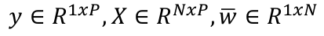
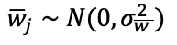
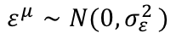
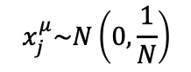
Student-Teacher formalism
Madhu Advani
$$x_{j}^{μ}\sim N\left(0,\frac{1}{N}\right)$$
$$y∈R^{1xP},X∈R^{NxP},\overline{w}∈R^{1xN}$$
$${\overline{w}}_{j}∼N(0,σ_{\overline{w }}^{2})$$
$$ε^{μ}∼N(0{,σ}_{ε}^{2})$$
$$w_{j}∼N(0,σ_{\overline{w}}^{2})$$

Slide 52
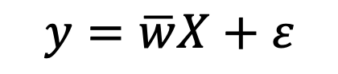

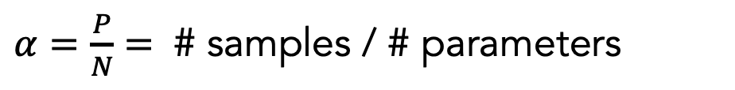
Student-Teacher formalism
Dataset of P training examples
High dimensional setting:
Intensively studied:
Asymptotic error ~1/P: Seung, Sompolinsky, & Tishby, 1992
Early stopping no help in asymptotic regime: Amari et al., 1995
Shallow network error: LeCun, Kanter, Solla, 1991
Fixed-batch shallow dynamics: Baldi & Chauvin, 1991; Krogh & Hertz, 1992
$$X=[x^{1},x^{2},…,x^{P}]$$
$$y=\overline{w}X+ε$$
$α=\frac{P}{N}=$ # samples / # parameters

Slide 53
Generalization dynamics

Slide 54
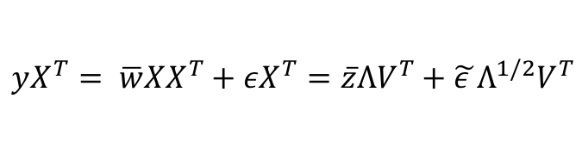
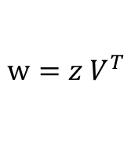
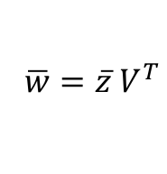
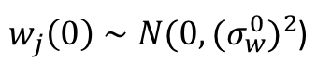
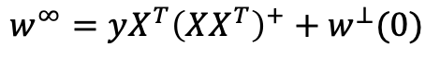
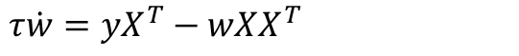

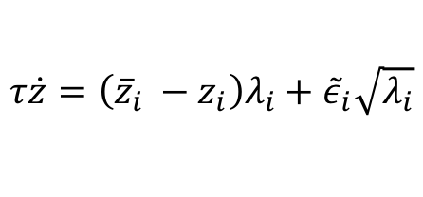
Analytic dynamics for shallow linear networks
Initialization:
$w_{j}\left(0\right)∼N(0,{{(σ}_{w}^{0})}^{2}$)
Learning dynamics:
$τ\dot{w}=yX^{T}−wXX^{T}$
Fixed point:
$$w^{∞}=yX^{T}{\left(XX^{T}\right)}^{+}+w^{⊥}(0)$$
Change of variables:
$$XX^{T}=VΛV^{T}$$
$$w=z V^{T}$$
$$\overline{w}=\overline{z} V^{T}$$
$$yX^{T}= \overline{w}XX^{T}+εX^{T}=\overline{z}ΛV^{T}+\tilde{ε }Λ^{1/2}V^{T}$$
$$τ\dot{z}=\left({\overline{z}}_{i} −z_{i}\right)λ_{i}+{\tilde{ε}}_{i}\sqrt{λ_{i}}$$
Dynamics expressed in terms of eigenvalues of random covariance matrix $XX^{T}$

Slide 55
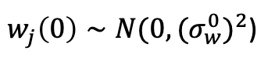
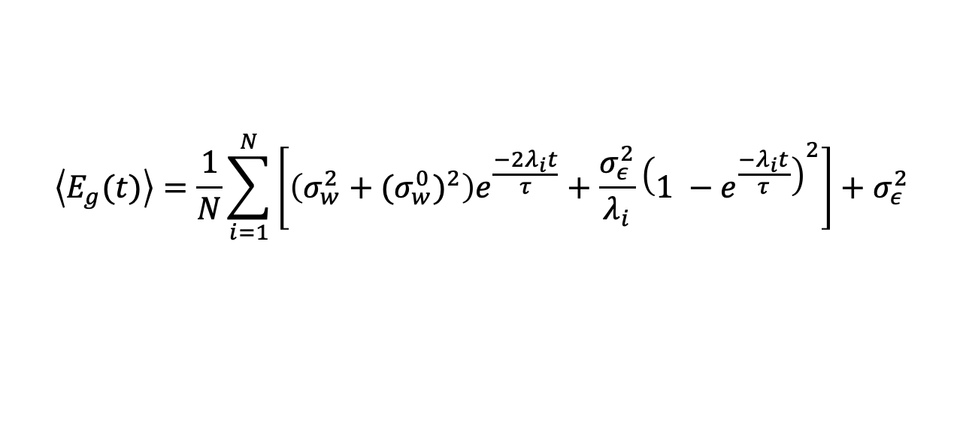
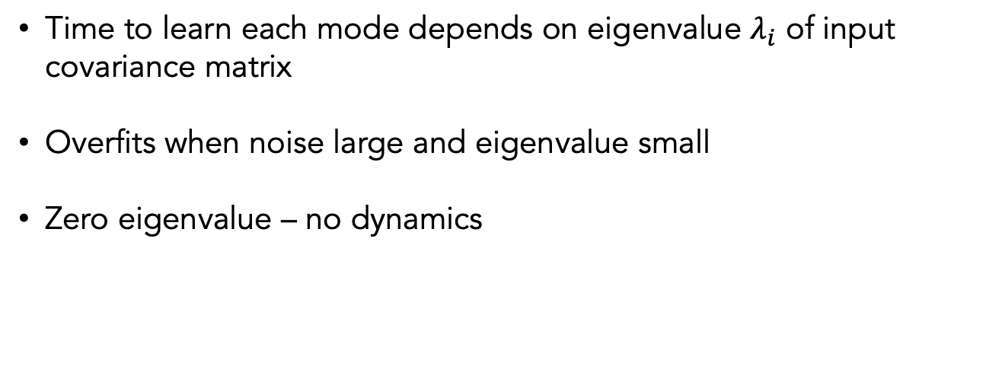
Generalization dynamics
Initialization:
$w_{j}\left(0\right)∼N(0,{{(σ}_{w}^{0})}^{2}$)
$$\left\langle E_{g}(t)\right\rangle =\frac{1}{N}\sum_{i=1}^{N}{\left[\left(σ_{w}^{2}+{{(σ}_{w}^{0})}^{2}\right)e^{\frac{−2λ_{i}t}{τ}}+\frac{σ_{ε}^{2}}{λ_{i}}{\left(1 −e^{\frac{{−λ}_{i}t}{τ}}\right)}^{2}\right]}+σ_{ε}^{2}$$
Forget initialization
Overfit noise
Time to learn each mode depends on eigenvalue $λ_{i}$ of input covariance matrix
Overfits when noise large and eigenvalue small
Zero eigenvalue – no dynamics

Slide 56
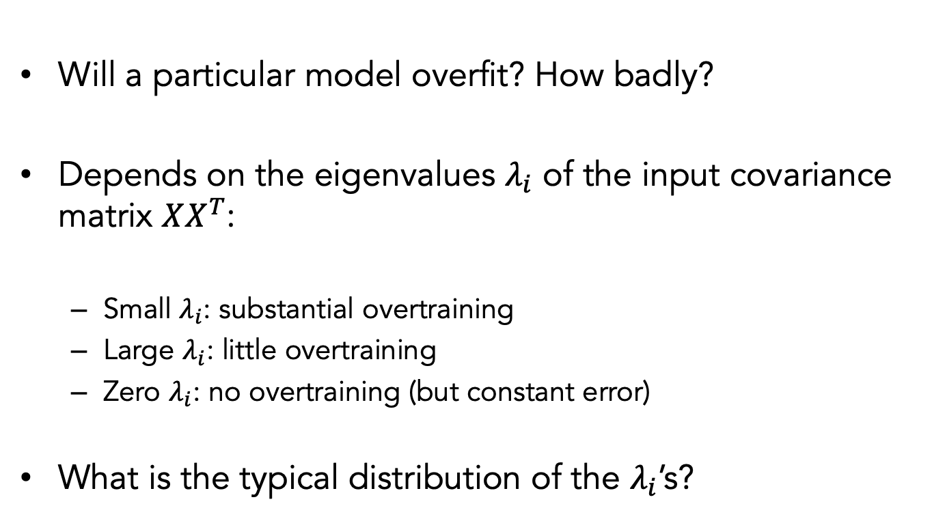
Input covariance spectrum
Will a particular model overfit? How badly?
Depends on the eigenvalues $λ_{i}$ of the input covariance matrix $XX^{T}$:
Small $λ_{i}$: substantial overtraining
Large $λ_{i}$: little overtraining
Zero $λ_{i}$: no overtraining (but constant error)
What is the typical distribution of the $λ_{i}$’s?

Slide 57
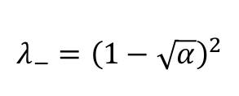
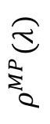
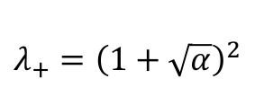
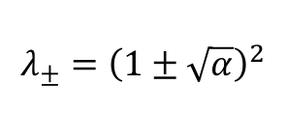
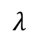
Marchenko-Pastur Distribution
In high dimensional regime, eigenvalues distributed as:
$$λ_{±}={\left(1±\sqrt{α}\right)}^{2}$$
$$λ_{−}={\left(1−\sqrt{α}\right)}^{2}$$
$λ_{+}={\left(1+\sqrt{α}\right)}^{2}$
$$ρ^{MP}\left(λ\right)$$
“Bulk”
Marchenko & Pastur, 1967
“Spike”
$$λ$$

Slide 58
Generalization dynamics
Combining MP distribution with exact solutions yields full generalization dynamics

Slide 59
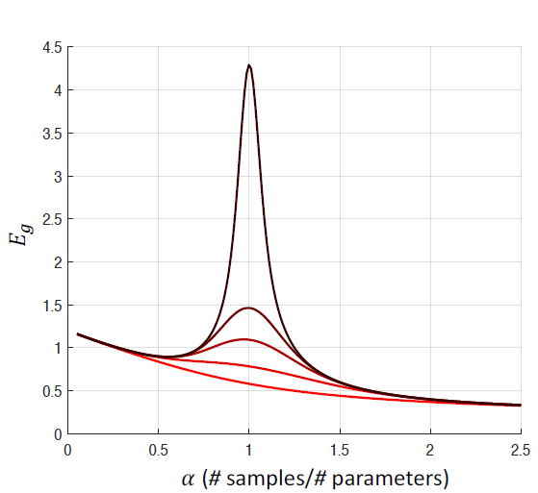
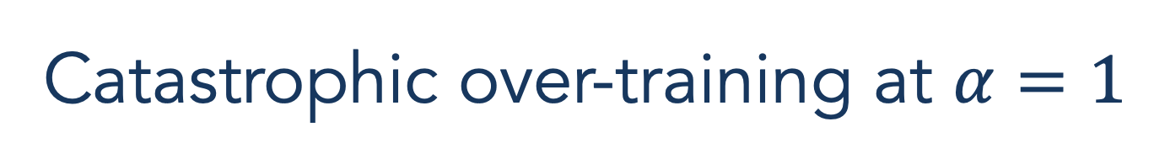
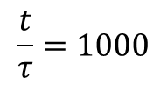
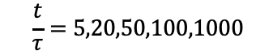
Catastrophic over-training at $α=1$
$$\frac{t}{τ}=5,20,50,100,1000$$
$$\frac{t}{τ}=1000$$
Test error
Overfitting is worst at intermediate amount of data
LeCun, Kanter, Solla. 1991; Krogh & Hertz, 1992; Opper & Kinzel, 1995; Advani & Saxe, 2017; Spigler et al., 2018; Belkin et al., 2018
Notes:
Overtraining is particularly damaging when the number of samples equals the number of parameters.
This is the point where the model becomes able to exactly fit every data point.
Directions where the input x has low amplitude in the data set leads to large weight growth (learning the noise).

Slide 60
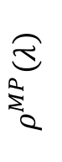
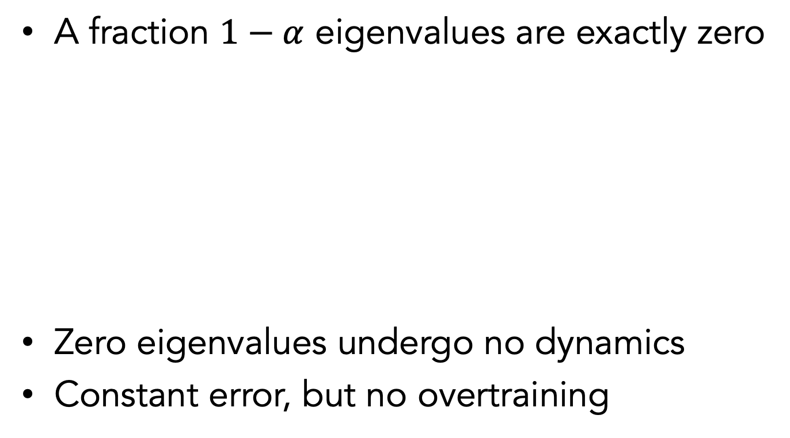
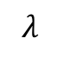
Frozen subspace
A fraction $1−α$ eigenvalues are exactly zero
Zero eigenvalues undergo no dynamics
Constant error, but no overtraining
$$ρ^{MP}\left(λ\right)$$
$$λ$$

Slide 61
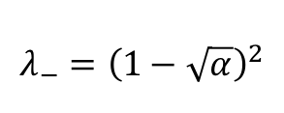
Eigengap
Minimum nonzero eigenvalue increases in high-dimensional regime
$$λ_{−}={\left(1−\sqrt{α}\right)}^{2}$$

Slide 62
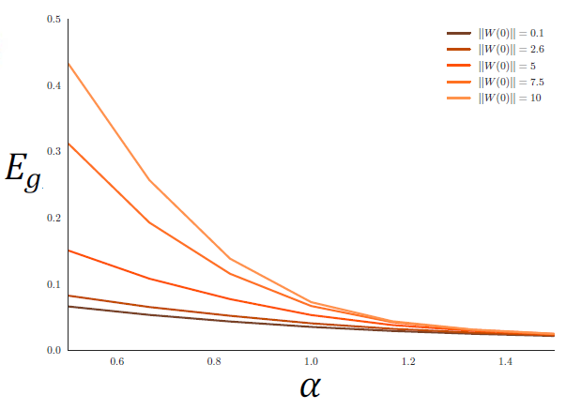
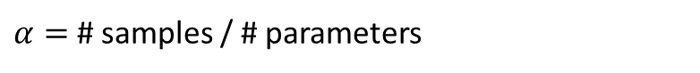
Impact of initial weight size
Generalization depends on SNR
and initialization noise ratio (INR)
$α=$ # samples / # parameters
In high-dimensional regime, small initial weights are critical for good generalization

Slide 63
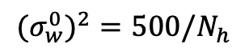
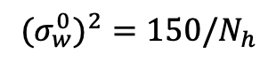

Impact of initial weight size
$${{(σ}_{w}^{0})}^{2}=1/N_{h}$$
$${{(σ}_{w}^{0})}^{2}=150/N_{h}$$
$${{(σ}_{w}^{0})}^{2}=500/N_{h}$$

Slide 64

Early stopping
Much better off stopping training early, a widely used strategy in practice
$$α (\# \text{examples}\text{/}\# \text{parameters}\text{)}$$
Cf. LeCun, Kanter, & Solla, 1991

Slide 65




Nonlinear student/teacher (ReLU)
$$N_{i}=15, P=300$$
examples,
Random, fixed first layer weights
$$N_{t}=30$$

Slide 66
Nonlinear teacher, fixed first layer
Error
Average over 50 runs at each size, shaded region: standard error of mean
Models trained for 150,000 epochs to show long-time behavior

Slide 67
Nonlinear teacher, fixed first layer
Error
Performance improves with increasing width of student network.
Largest model: 545x larger than teacher, 54x larger than # examples.

Slide 68
Hidden layer covariance spectrum

Slide 69
Verification in SOTA networks
Several verifications in nonlinear settings (Spiegler et al., 2018; Belkin et al., 2019)
Deep Double Descent: where bigger models and more data hurt. ICLR OpenReview 2019
CIFAR 10
Language
Transformer

Slide 70
Related phenomena
Langevin dynamics? Random walk in data nullspace yields diverging test error (Krogh & Hertz, 1992)
Distance from initialization? Can start close to solution in data subspace, but far in data nullspace, yielding large test error despite small movement
Ensembling? Nullspace weights are mean zero, so averaging repeats can help

Slide 71

Sharp minima?
For linear regression, Hessian is $XX^{T}$
All minima are equally ‘sharp,’ but can generalize differently
Intuition: The data nullspace is a totally flat direction for training error; variability in data nullspace causes different test performance
Sharpness measures may capture additional contributions to generalization in nonlinear networks
Zhang, Y., Saxe, A. M., Advani, M. S., & Lee, A. A. (2018). Energy-entropy competition and the effectiveness of stochastic gradient descent in machine learning. Molecular Physics.

Slide 72
Summary: generalization in linear models
Generalization can be decent in overparametrized networks even with infinite training time because of interaction of algorithm, data, and model properties:
Frozen subspace: minimal movement in data nullspace
Eigengap: better conditioned input correlations
Small initialization: no contributions from data nullspace
Bigger is not always better (depends on noise properties)
Depth & nonlinearity: L₂ norm no longer the right complexity metric
For more:
Advani*, M., & Saxe*, A. M. (2017). High-dimensional dynamics of generalization error in neural networks. arXiv
Hastie, T., Montanari, A., Rosset, S., Tibshirani, R.J. (2019) Surprises in High-Dimensional Ridgeless Least Squares Interpolation. arXiv

Slide 73

Speed-accuracy tradeoff
Fast training requires large weights
Good generalization requires small weights
ReLU net learning from linear teacher, SNR=10, N=50, P=500, N_{h}=100

Slide 74

Speed-accuracy tradeoff
Current initialization suggestions are optimized for training speed, not generalization performance
CIFAR10 5 layer Conv net, SGD, batch size 128, constant LR

Slide 75

Initialization dependence in more complex architectures
Batch norm residual networks appear to alleviate training speed tradeoff
Small initializations confer generalization benefit

Slide 76
Summary
Depth causes rich dynamical phenomena over training
Good generalization appears to depend on complex interplay of data, algorithm, and architecture
Overparameterized models can generalize well even at infinite training times due to approximately frozen subspace of weights and better input conditioning
Unlike shallow networks, deep dynamics depend substantially on knowledge already in the network

Slide 77
References
Advani*, M., & Saxe*, A. M. (2017). High-dimensional dynamics of generalization error in neural networks. arXiv.
S. Goldt, M.S. Advani, A.M. Saxe, F. Krzakala and L. Zdeborová. Dynamics of stochastic gradient descent for two-layer neural networks in the teacher-student setup. NeurIPS 2019. (arXiv:1906.08632)
Saxe, A. M., McClelland, J. L., & Ganguli, S. (2019). A mathematical theory of semantic development in deep neural networks. PNAS.

Slide 78
Acknowledgements
Warm thanks to
Chris Summerfield
Tim Behrens
Haim Sompolinsky
David Cox
James McClelland
Surya Ganguli
Members of Summerfield, Sompolinsky, Cox, McClelland, Ganguli, Ng, & Schreiner labs
Support: ERC Neuroabstraction, IARPA Microns, Swartz Foundation
Andrew Ng
Christoph Schreiner
Madhu Advani
Sebastian Goldt
Florent Krzakala
Lenka Zdeborová
Yamini Bansal
I’m hiring!
andrew.saxe@psy.ox.ac.uk

